Slide 1

The Vinyl Station
-Divya Thota
Notes:
What does your app do?

Slide 2
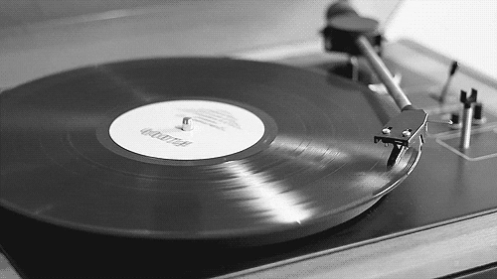

Introduction
What is a Vinyl Record?

Slide 3
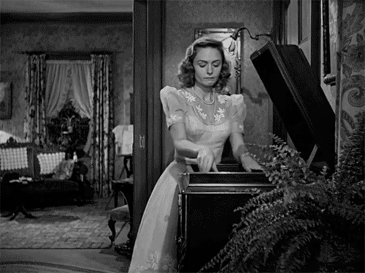

Introduction
Vinyl Records are made from heated polyvinyl chloride that has been pressed thin with grooves that produce sound.
They were a commercial form of music storage and reproduction since as early as the 1800s,
Around 1991 was the downfall in the market share of vinyl records when compact discs (CD) started gaining market popularity.

Slide 4
Introduction
However, vinyls are making a huge comeback since the 2000s.
Collectibility
Audio Quality
Physical Album
Nostalgia
Global Vinyl Records market size is estimated to be worth US$ 239.4 million in 2021 and is forecast to a readjusted size of US$ 643.9 million by 2028.

Slide 5

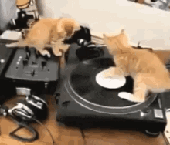
The Vinyl Station
Rediscover the magic of music.

Slide 6
ER Diagram
Band
Customer
Creates
Purchases
Has
make
Tracks
Record
Employee

Slide 7
Schema Diagram
Band/Artist
id | Name | Password | Band Members | Description
Genre
id | Genre Name
RecordType
id | Type Name | Duration
Tracks
id | Track Name | Genre Id | URL | Duration | Price | Band Id
RecordTrack
id | Record Id | Track Id | Added
Customer
id | First Name | Last Name | Email | Password | Address | City | State | Zip code | Country | Credit card Type | Credit card Number | Credit Card Expiration date
Invoice
id | Customer Id | Date | Status | Total Price | Employee Id
Record
id | Duration | Price | Type Id | Status | Invoice Id
Employee
id | First Name | Last Name | Email | Password | Address | City | State | Zip code | Country | Phone Number | Date of Birth | Role

Slide 8
Login Page

Slide 9




Enter Username/Email
Enter Password
Login
Or
Need an Account? Sign Up/Register

Slide 10
Artist/Band Page

Slide 11



Welcome Linkin Park,
Home
Tracks
Profile
Create Track
Drag and Drop or Select Track
Track Name
Genre
Your Selling Tracks :
Duration
Tracks | Purchases
In the End | 20k
Breaking the Habit | 18k
Numb | 15k
Castle of Glass | 13k
Create Track

Slide 12
Artist/Band
//Creates Tracks public void createTracks(String trackName, String Genre, String url, double Duration, double Price, int band_id) throws ServiceException {
//View Top Tracks public HashMap<String, Integer> getTopTracks()throws ServiceException{
//View Total number of Purchases over the years public HashMap<Integer, Integer> getPurchases(int band_id) throws ServiceException {
//View all their tracks public List<Tracks> getTracks(int band_id) throws ServiceException {
//View Profile public Band getBand(int band_id) throws ServiceException {

Slide 13
Customer Page

Slide 14



Welcome Austin,
Home
Search
Orders
Profile
# 1 In The End
Linkin Park
Your Previous Orders :
Order Number | Order Date | Status
527837096348987095 | 04/07/2023 | Order Placed
434297514163275408 | 04/07/2023 | Processing
765418742085270632 | 04/08/2023 | Out for Delivery
179285567830365573 | 04/09/2023 | Delivered

Slide 15


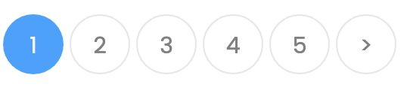
Welcome Austin,
Home
Search
Orders
Profile
Choose record type
Search tracks…
Long-Playing Vinyl Records (L.P.)
18 minutes
+ New Record
Sort by: Popularity
In the End
Breaking the Habit
Numb
Castle of Glass
As it was
Animals
Happier
Next, Thank you
Add to Record
Add to Record
Add to Record
Extended Play Vinyl Records (E.P.)
30 minutes
Add to Record
Add to Record
Add to Record
Add to Record
Add to Record

Slide 16
Welcome Austin,
Home
Search
Orders
Profile
Product #25930:
Shipping Address:
100 Morrissey Blvd, University of Massachusetts, Boston 02125
Tracks | Price
In the End | $4.00
Breaking the Habit | $3.00
Numb | $2.00
Castle of Glass | $1.00
Subtotal : $ 17.00
Shipping : $ 1.20
Sales Tax: $ 0.75
Total : $25.00
Item Total Price: $ 10.00
Product #25931:
Tracks | Price
Happier | $4.00
Next, Thank you | $3.00
Checkout
Item Total Price: $ 7.00

Slide 17
Customer
//View Top Tracks public HashMap<String, Integer> getTopTracks()throws ServiceException
//View all tracks public List<Tracks> getTracks() throws ServiceException {
//View all their Orders public List<Orders> getOrders(String customer_id) throws ServiceException {
//Create Record and Invoice public void makeRecordInvoice(int customer_id, int record_type_id, double duration, double price) throws ServiceException {
//Search Tracks
//Create RecordTrack and Update Record Price and Duration public void makeRecordTrack(int record_id, int track_id) throws ServiceException {
//Update Invoice Status public void updateInvoiceStatus(int invoice_id) throws ServiceException {
//View Profile public Customer getCustomer(int customer_id) throws ServiceException {
//Create Customer
public void CreateCustomer(String first_name, String last_name, String email, String password, String address, String city, String state, String postal_code, String country, String credit_card_type, int credit_card_no, String credit_card_expiration_date) throws ServiceException {

Slide 18

Employee Page

Slide 19


Welcome Jane,
Home
Records
Profile
Order 527837096348987095
Record #25930:
Record #25931:
Pending Orders:
Invoice Number | Order Date
527837096348987095 | 04/07/2023
434297514163275408 | 04/07/2023
765418742085270632 | 04/08/2023
179285567830365573 | 04/09/2023
Tracks | ID
In the End | 5348
Breaking the Habit | 7836
Numb | 2387
Castle of Glass | 5861
Make Order
Make Order
Make Order
Make Order
Make Order
You Progress :
Month | Orders
January | 20
February | 18
March | 25
April | 16
Tracks | ID
Unfaithful | 5487
Done

Slide 20
Employee
//View Pending Orders public List<Invoice> getPendingOrders()throws ServiceException
//View monthly progress public HashMap<String, Integer> ViewMonthlyProgress(int employee_id)throws ServiceException{
//View Team Performance public HashMap<String, Double> getTeamPerformance() throws ServiceException {
//Update Invoice Status public void updateInvoiceStatus(int invoice_id, String status) throws ServiceException {
//Update record Status public void updateRecordStatus(int record_id, String status) throws ServiceException {
// Update RecordTrack Added field public void updateRecordTrack(int record_track_id) throws ServiceException {
//View invoices they created public List<Invoice> getInvoices(int employee_id) throws ServiceException {
//View Profile public Employee getEmployee(int employee_id) throws ServiceException {

Slide 21
Code

Slide 22
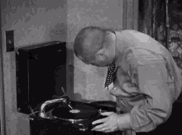
Any Questions?

Slide 23
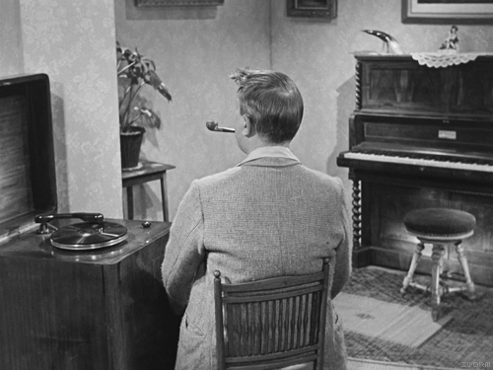

Thank You

